Slide 1
Topic: Relative size of negative numbers EQ: What is the relative size of negative numbers?
Year 11 Essentials
Mrs Parlevliet

Slide 2
Things Required For This Lesson
Interactive Notebook
Textbook: Interleaved Maths Essential Connections
Ruler, Red Pen, Pencil, Pens, Scientific Calculator
Growth mindset

Slide 3

24
7
30
Topic: Relative Size of Negative Numbers
Date: 12/02/2021
EQ: What is the relative size of negative numbers?
WICOR
This Photo by Unknown Author is licensed under CC BY-SA

Slide 4

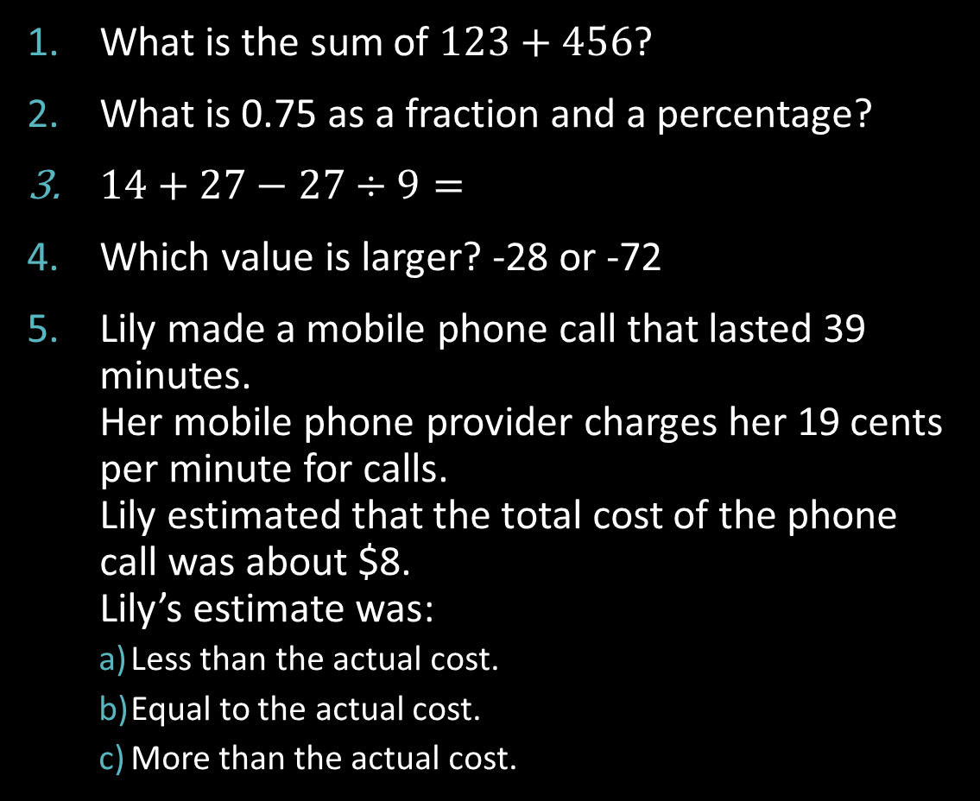
Five Questions (LHS)
What is the sum of $123+456$?
What is 0.75 as a fraction and a percentage?
$14+27−27÷9=$
Which value is larger? -28 or -72
Lily made a mobile phone call that lasted 39 minutes. Her mobile phone provider charges her 19 cents per minute for calls. Lily estimated that the total cost of the phone call was about $8. Lily’s estimate was:
Less than the actual cost.
Equal to the actual cost.
More than the actual cost.

Slide 5
Task (LHS) Think Pair Share
Draw a number line that begins at -100 and ends at 100. Place the numbers, -50, 25, 0, -75, 50, 75 on your number line.
Compare your answer with the person next to you and discuss how you placed the numbers on the number line.
If you want to make changes to your answer, draw another number line underneath your original work with your new answer.
Be prepared to contribute to a whole class discussion.
Notes:
Have post-it notes pre-prepared with -50, 25, 0, -75, 50, 75 for whole class display on the board

Slide 6
24
7
30
Topic: Relative size of Negative Numbers
Date: 12/02/2021
EQ: What is the relative size of negative numbers?
Negative Numbers
They are used in many real life situations:
Finance
Credit cards and loans to show how much you owe to the bank
Temperatures in very cold locations
Monitoring of internet data allowances
WICOR

Slide 7
Task (LHS) Work With Shoulder Partner
Together with your shoulder partner, write equations for these situations:
Start at 75, end at 25: what happened?
Start at 25, end at 75: what happened?
Start at 25, end at -50: what happened?
Start at -50, end at 20: what happened?
Be prepared to take part in the class discussion about this work.
Notes:
Review understanding of equations.
Use CUBES strategy to break down question.
Circle the numbers
Underline the question
Box math keywords
Eliminate unnecessary information
Solve and check whether your answer is reasonable

Slide 8


TASK (LHS) Report WRiting
Answer the following questions:
How is $75−25$ similar to $25−75$? Why?
Would this same pattern apply to other numbers?
Test your pattern with $8−3$ and $3−8.$
Now test your pattern with $17−3$ and $3−17$.
Would this pattern always be true or sometimes?
If this is true, explain how you can use it to subtract larger numbers from smaller numbers.
Notes:
Scaffolding for students
Introduction: Rephrase the question and explain what the problem is that needs to be solved
Body: Identify what mathematical skills are needed and show the mathematical working out
Results: Show and explain the findings
Conclusion: Answer the question clearly. Show where else the findings also apply and to show excellent understanding, include real life examples.

Slide 9
24
7
30
Topic: Relative size of Negative Numbers
Date: 12/02/2021
EQ: What is the relative size of negative numbers?
Negative Numbers
They are used in many real life situations:
Finance
Credit cards and loans to show how much you owe to the bank
Temperatures in very cold locations
Monitoring of internet data allowances
WICOR
Write your Summary including:
The strategy to use when subtracting a larger number from a smaller number.
Include your own example.

Slide 10

Thank you
Thank you for a good start to Year 11 Mathematics Essentials.
See you all after the weekend.

